Slide 1
Clean Coding Principles

Slide 2
1.
Meaningful Names
Ref: Clean Code – Robert C. Martin
Chapter 2

Slide 3

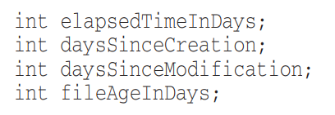
Use Intention Revealing Names
Choosing good names takes time but saves more than it takes
Name should answer all the big questions: Why, What, How
If a name requires a comment, then the intent is not revealed
BAD 😒
GOOD 😸

Slide 4
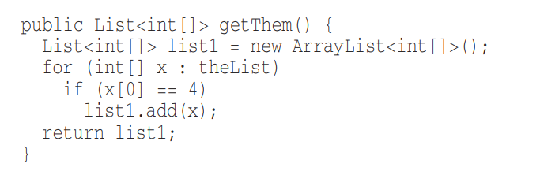
Use Intention Revealing Names Contd.
What is the purpose of this code?
😒

Slide 5
Use Intention Revealing Names Contd.
What is the purpose of this code?
😒
What kind of things are in the list?
What is the significance of the first element in the list?
What is the significance of the value 4?
How do we use the list being returned?

Slide 6
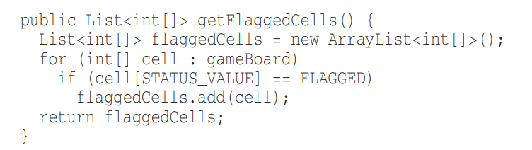
Use Intention Revealing Names Contd.
The code is for a minesweeper game, here’s an improved version
😏
What kind of things are in the list? It represents the game board
What is the significance of the first element in the list? It is the location of a status value
What is the significance of the value 4? Status == Flagged
How do we use the list being returned? It is a list of flagged cells

Slide 7
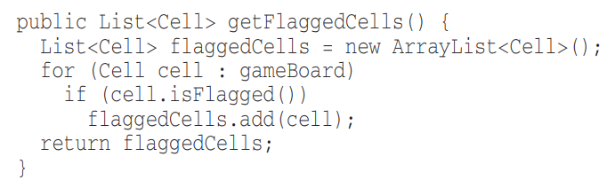
Use Intention Revealing Names Contd.
Improving it further
😸
Class introduced for Cell
isFlagged function used to hide magic numbers

Slide 8


Avoid Disinformation
Don’t make others lead to false conclusions about your code
BAD 😒
GOOD 😸

Slide 9
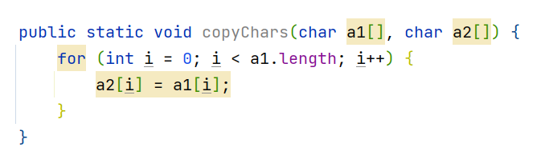
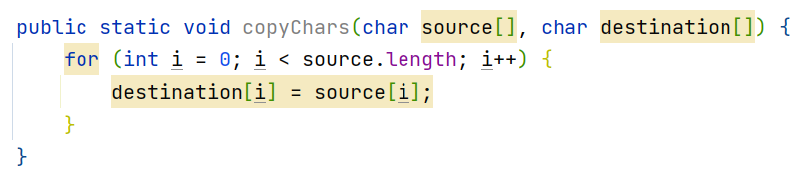
Make Meaningful Distinctions
Ex: number series naming
  Noninformative
  Provide no clue to the reader
BAD 😒
GOOD 😸

Slide 10
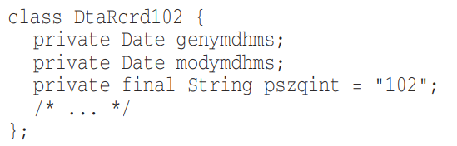
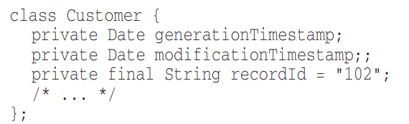
Use Pronouncable Names
“genymdhms” – can you pronounce this?
  generation date, year, month, day, hour, minute, and second)
BAD 😒
GOOD 😸

Slide 11
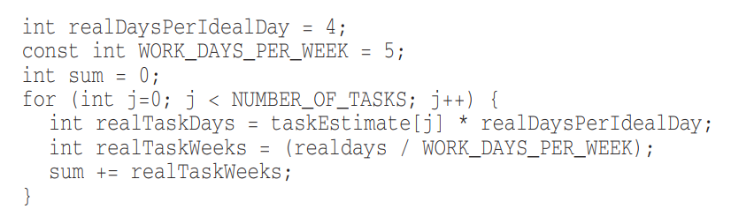
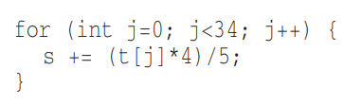
Use Searchable Names
Single letter names should only be used as local variables inside very small methods
  Length of the name should correspond to the size of the scope
If a variable might be used in multiple places in a body of code, you must give it a searchable name
BAD 😒
GOOD 😸

Slide 12


Avoid Encodings – Hungarian Notation
This was used when there were limitations in type checking and strong typing
BAD 😒
GOOD 😸

Slide 13
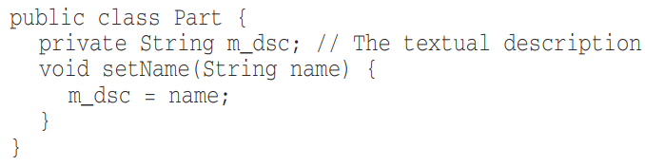
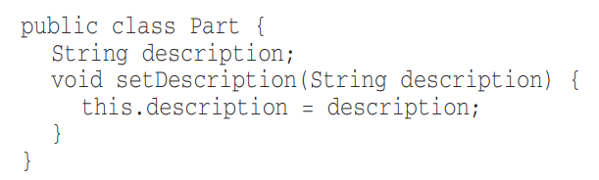
Avoid Encodings – Member Prefixes
You don’t need to prefix member or instance variables with “m_”
BAD 😒
GOOD 😸

Slide 14
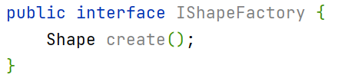
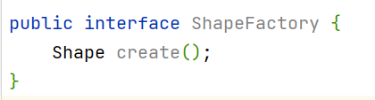

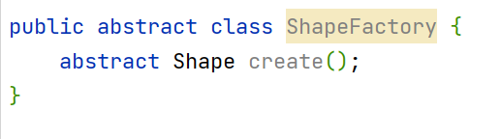
Avoid Encodings – Interfaces and Implementations
Users don’t need to know whether they are using an interface or abstract class
BAD 😒
GOOD 😸

Slide 15
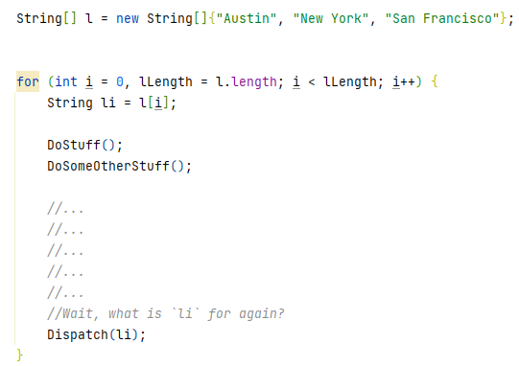
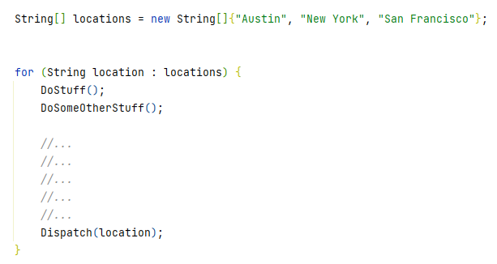
Avoid Mental Mappings
Readers shouldn’t have to mentally translate your names into other names
BAD 😒
GOOD 😸

Slide 16
Class Names
Classes and objects should have Noun or Noun phrase Names
SHOULD NOT BE A VERB
BAD 😒
GOOD 😸
Manager
Processor
Data
Info
Customer
Account
Address
AddressParser

Slide 17
Method Names
Methods should have Verb or Verb phrase Names
BAD 😒
GOOD 😸
customer.name(“John”);
report.data();
supplier.postPayment(address);
report.save();
customer.getName();
customer.setName(“John”);

Slide 18
One word per concept
Ex: it’s confusing to have fetch, retrieve, and get as equivalent methods of different classes
BAD 😒
GOOD 😸
monthlyReport.getCustomers();
monthlyReport.fetchLoyalCustomers();
monthlyReport.retreiveSuppliers();
monthlyReport.getCustomers();
monthlyReport.getLoyalCustomers();
monthlyReport.getSuppliers();

Slide 19
Use Solution Domain Names
Readers are also programmers
Use Computer Science terms in code
  BubbleSort, AccountVisitor, JobQueue
Use Problem Domain Names
When you don’t have words from the solution domain, use names from the problem domain

Slide 20
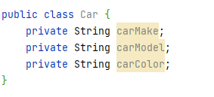
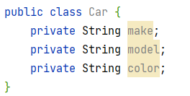
Don’t Add Unncessary Context
Add no more context to a name than necessary
  Shorter names are generally better than larger ones
BAD 😒
GOOD 😸

Slide 21
2.
Functions
Ref: Clean Code – Robert C. Martin
Chapter 3

Slide 22
SMALL!!
Rule 1: Functions Should be Small!
Rule 2: They should be smaller than that!!

Slide 23
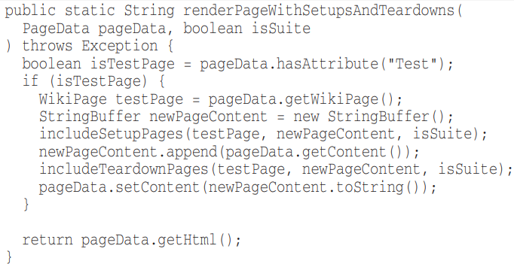
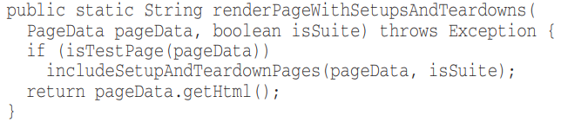
Blocks and Indenting
Keep code within if, else, while etc. blocks to one line
NOT THE BEST😒
GOOD 😸

Slide 24
FUNCTIONS SHOULD DO ONE THING. THEY SHOULD DO IT WELL.
THEY SHOULD DO IT ONLY.

Slide 25
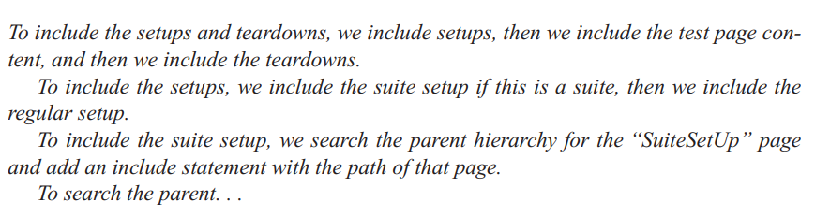
One Level of Abstraction per Function
Concepts at a higher level of abstraction should not be mixed with concepts at a lower level of abstraction
Follow the step-down rule

Slide 26
Use Descriptive Names
Long descriptive names are better than short confusing names
Spend time to choose a good name.
  Try several different names and read the code
Be consistent with names
Name should answer all the big questions: Why, What, How
If a name requires a comment, then the intent is not revealed

Slide 27
Function Arguments/Parameters
Ideally zero parameters (Niladic)
Next, one parameter (Monadic)
Next, two parameters (Dyadic)
Next, three parameters (Triadic) – Try to avoid where possible
More than three (Polyadic) – Must Avoid or atleast have a good justification

Slide 28
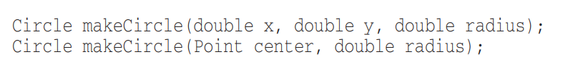
Function Arguments/Parameters
When more than two or three arguments are required, the arguments can be wrapped into a class of their own.

Slide 29
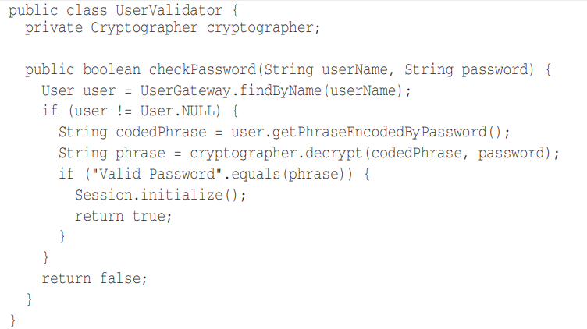
Have No Side Effects
Function promises to do one thing, but it also does other hidden things.

Slide 30
Command Query Separation
Functions should either do something or answer something but not both.

Slide 31
3.
Comments
Ref: Clean Code – Robert C. Martin
Chapter 4

Slide 32
Comments do not make up for bad code!

Slide 33


Explain yourself in code
Which would you rather see?
BAD 😒
GOOD 😸

Slide 34
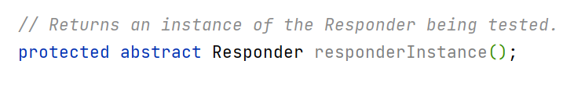
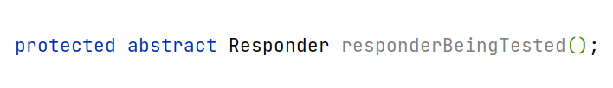

Informative Comments
Use the name of the function to convey information where possible
BAD 😒
GOOD 😸

Slide 35
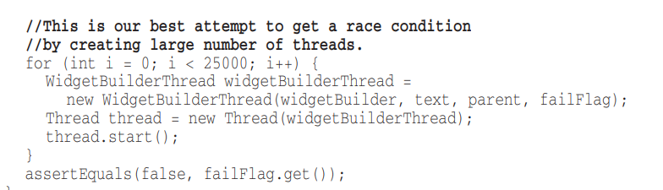
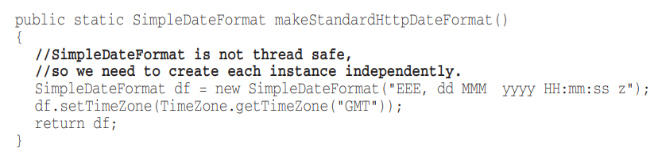
Explanation of Intent
Use comments to communicate decisions that were made

Slide 36
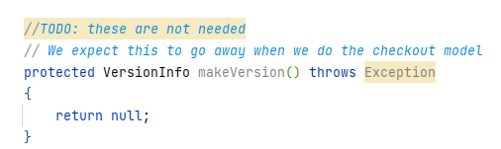
TODO
TODOs can be used to indicate work left for later
  Must be regularly cleaned and reduced

Slide 37
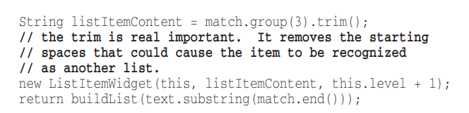
Amplification
Use comments to amplify the importance of something

Slide 38
If you decide to write a comment, then spend the time necessary to make sure it is the best comment you can write

Slide 39
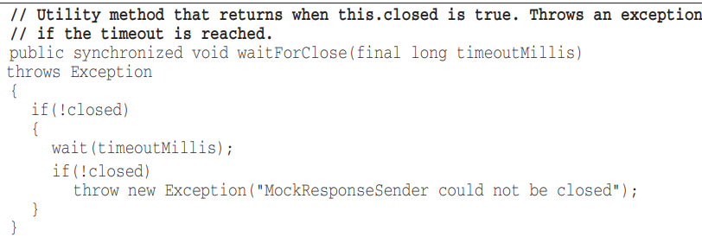
Redundant Comments
Reading the code itself might be faster than reading redundant/repetitive comments

Slide 40
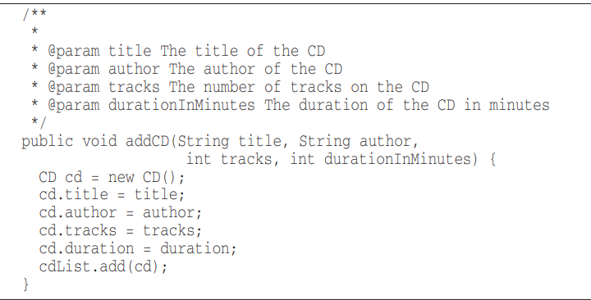
Mandated Comments
Not every function/param needs to have a Javadoc

Slide 41
4.
Formatting
Ref: Clean Code – Robert C. Martin
Chapter 4

Slide 42
Vertical Formatting
Try to maintain an upper limit of 500 lines per file
Should read like a newspaper
  First paragraph gives a synopsis
  As you go down, details are revealed

Slide 43
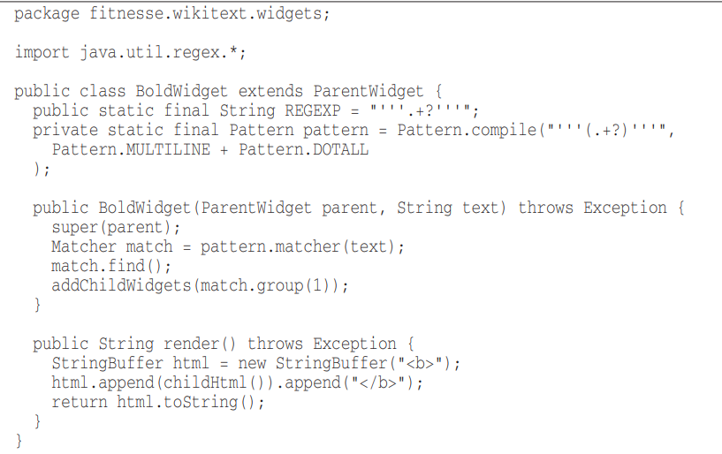
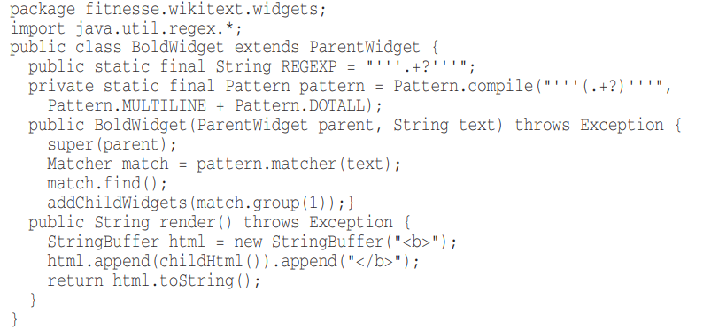
Vertical Openness between concepts
BAD 😒
GOOD 😸

Slide 44
Vertical Distance
Variables should be declared as close to their usage as possible
Instance variables, should be declared at the top of the class
If one function calls another, they should be vertically close, and the caller should be above the callee, if at all possible
  https://plugins.jetbrains.com/plugin/11005-clean-code-method-rearranger

Slide 45
Horizontal Formatting
Prefer short lines
  Prefer Max 80 characters per line

Slide 46
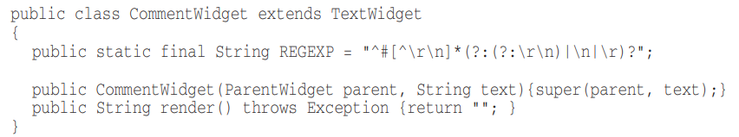
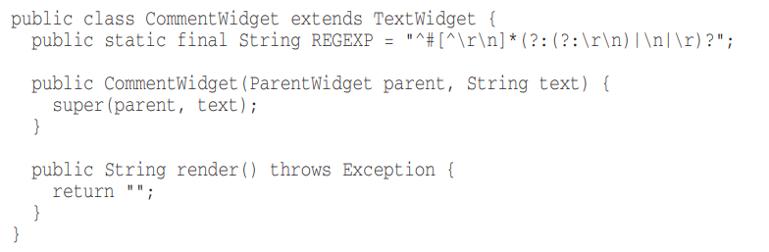
Indentation
Avoid collapsing scopes to one line
BAD 😒
GOOD 😸

Slide 47
Exercise
Get an old code base of yours (Java)
Find a minimum of 5 clean code principles violations
  What is the violation?
  Why is the principle important?
  What is the suggested fix?

Slide 48

Free templates for all your presentation needs
For PowerPoint and Google Slides
100% free for personal or commercial use
Ready to use, professional and customizable
Blow your audience away with attractive visuals

